Slide 1
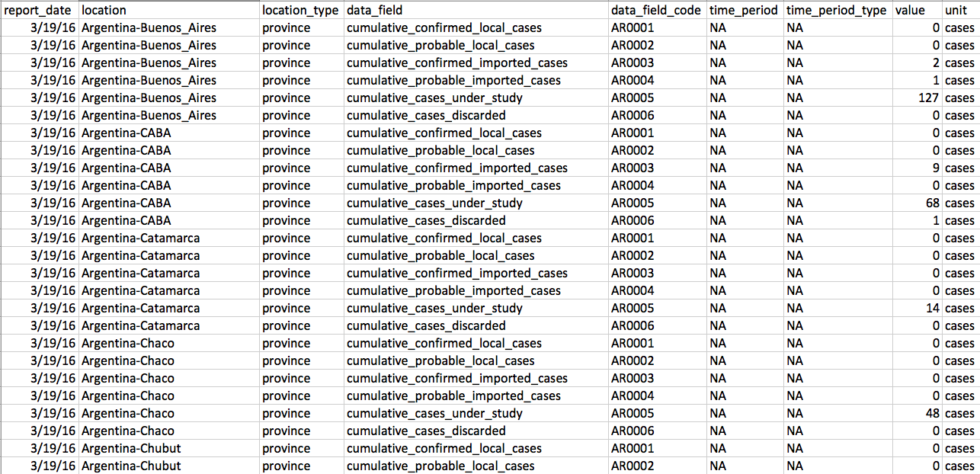

CDC Zika Survey
Notes:
For the deception project, I wanted to focus on the Zika virus. Here we can see the survey from the CDC website that shows the number of reported and confirmed cases per location. I’m going to be using this single dataset to create two opposing views

Slide 2
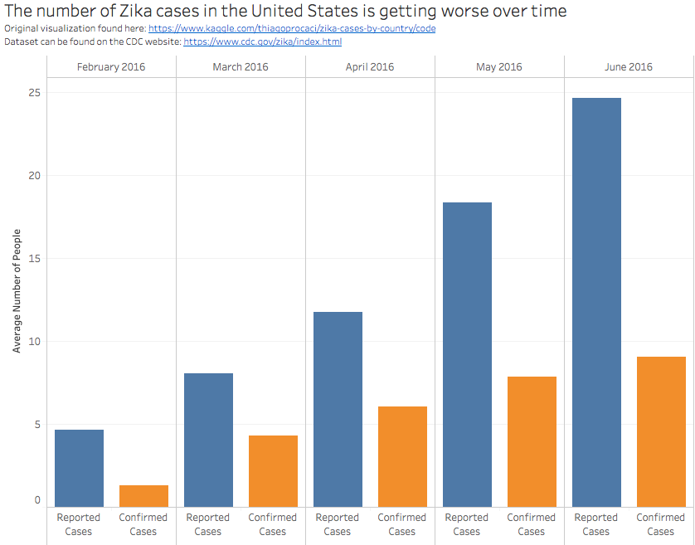
Notes:
-claim one: Zika virus is getting worse over time and we should definitely pay attention to it.
-Reported and confirmed cases keep increasing as the months progress and we want to avoid a sudden outbreak in the future

Slide 3
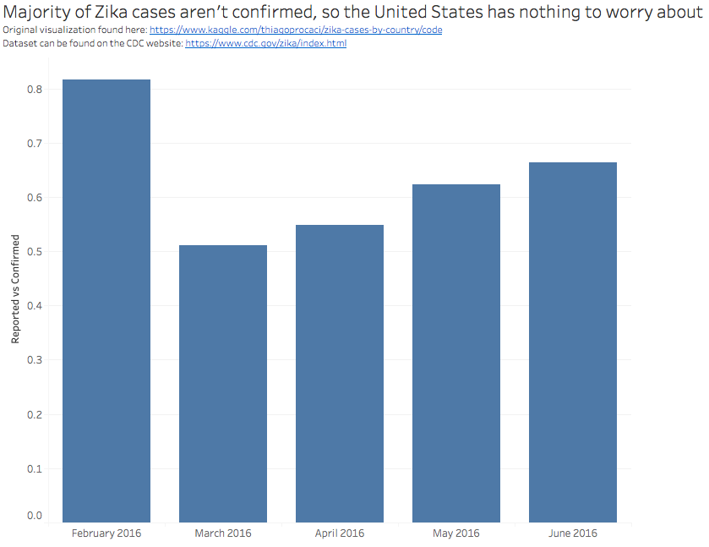
Notes:
-claim two: Zika is not getting worse and we should not take any further actions. Majority of the cases are reported and not confirmed. In addition, we haven’t seen as severe of a spike as we did back in February.
-I was able to create the two claims by slicing and dicing the data in Tableau
-Because of this, we can see how easy it is to manipulate the visualization to create a false claim

